Slide 1
SBB

Slide 2
Today
Goals and repository
Project presentation
Unit test
Wrong user input
Feedback implementation
Virtual environment
Further work

Slide 3
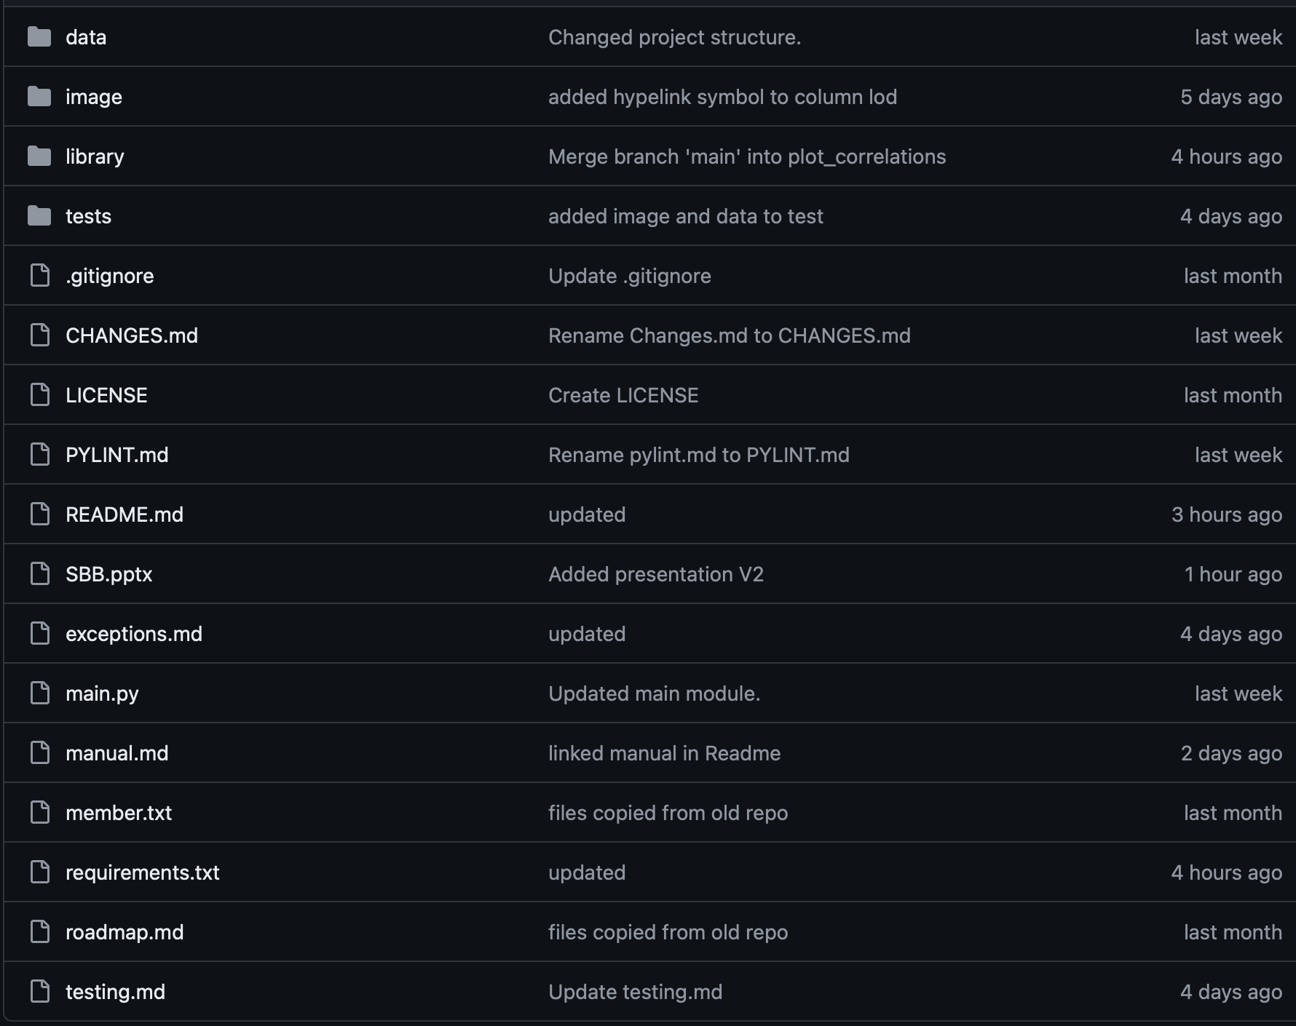
Goals and repository
Exploring the dataset
Interactive table
Interacting with the dataset
Filtering/Adding data
Visualize the data
Plotting functions

Slide 4
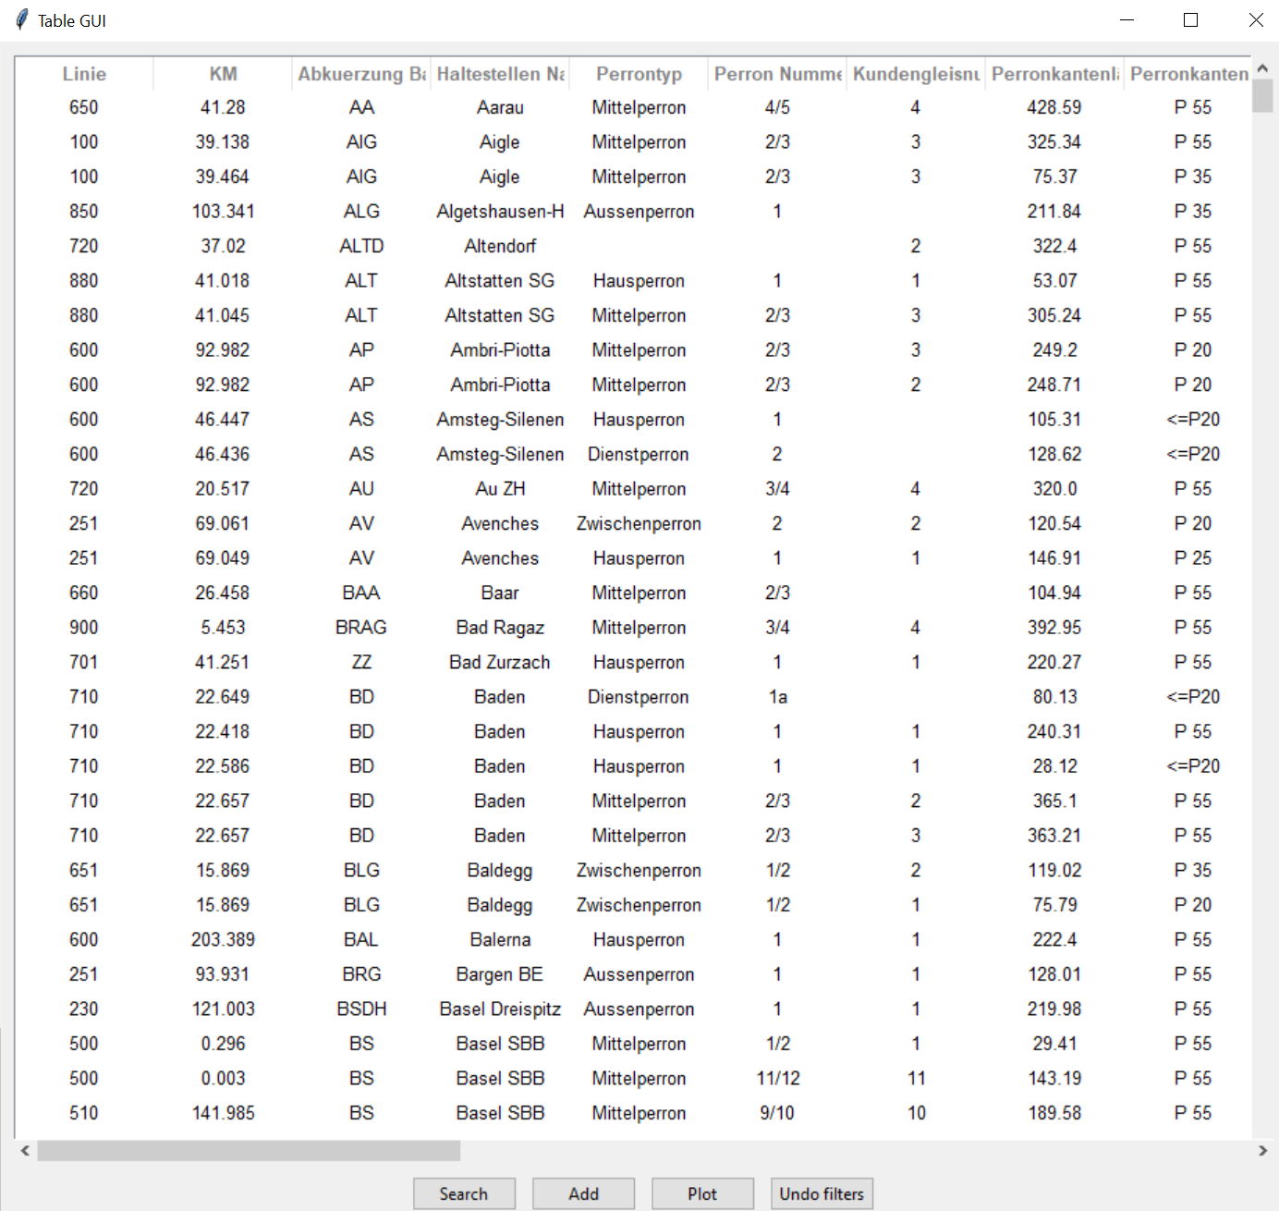
Interactive table
Search
Add
Plot
Undo filters

Slide 5
Interactive number columns

Slide 6
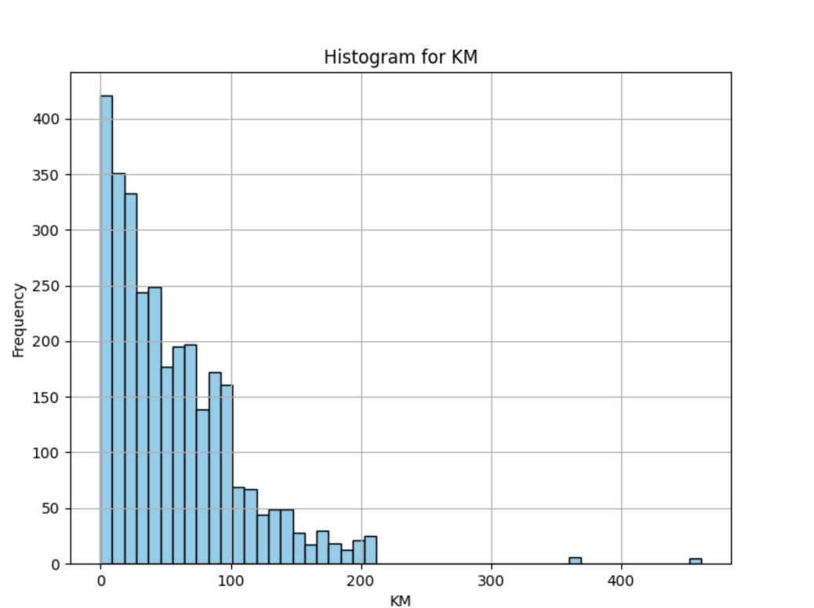
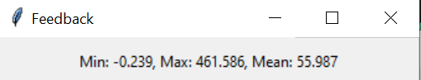
Result

Slide 7
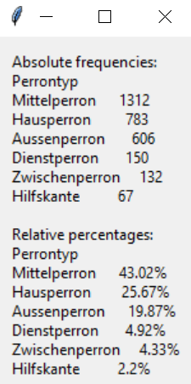
Interactive categorical values

Slide 8
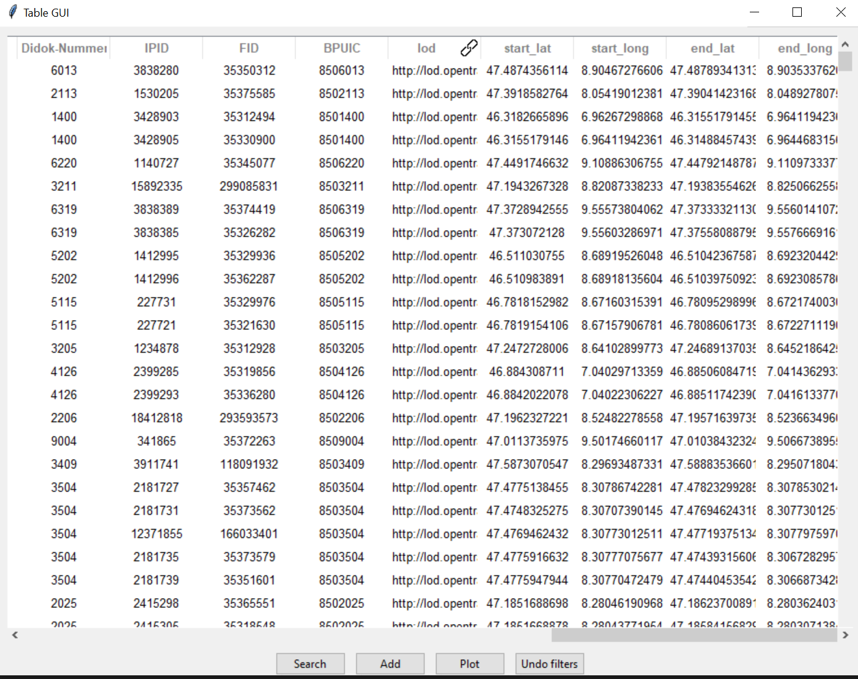
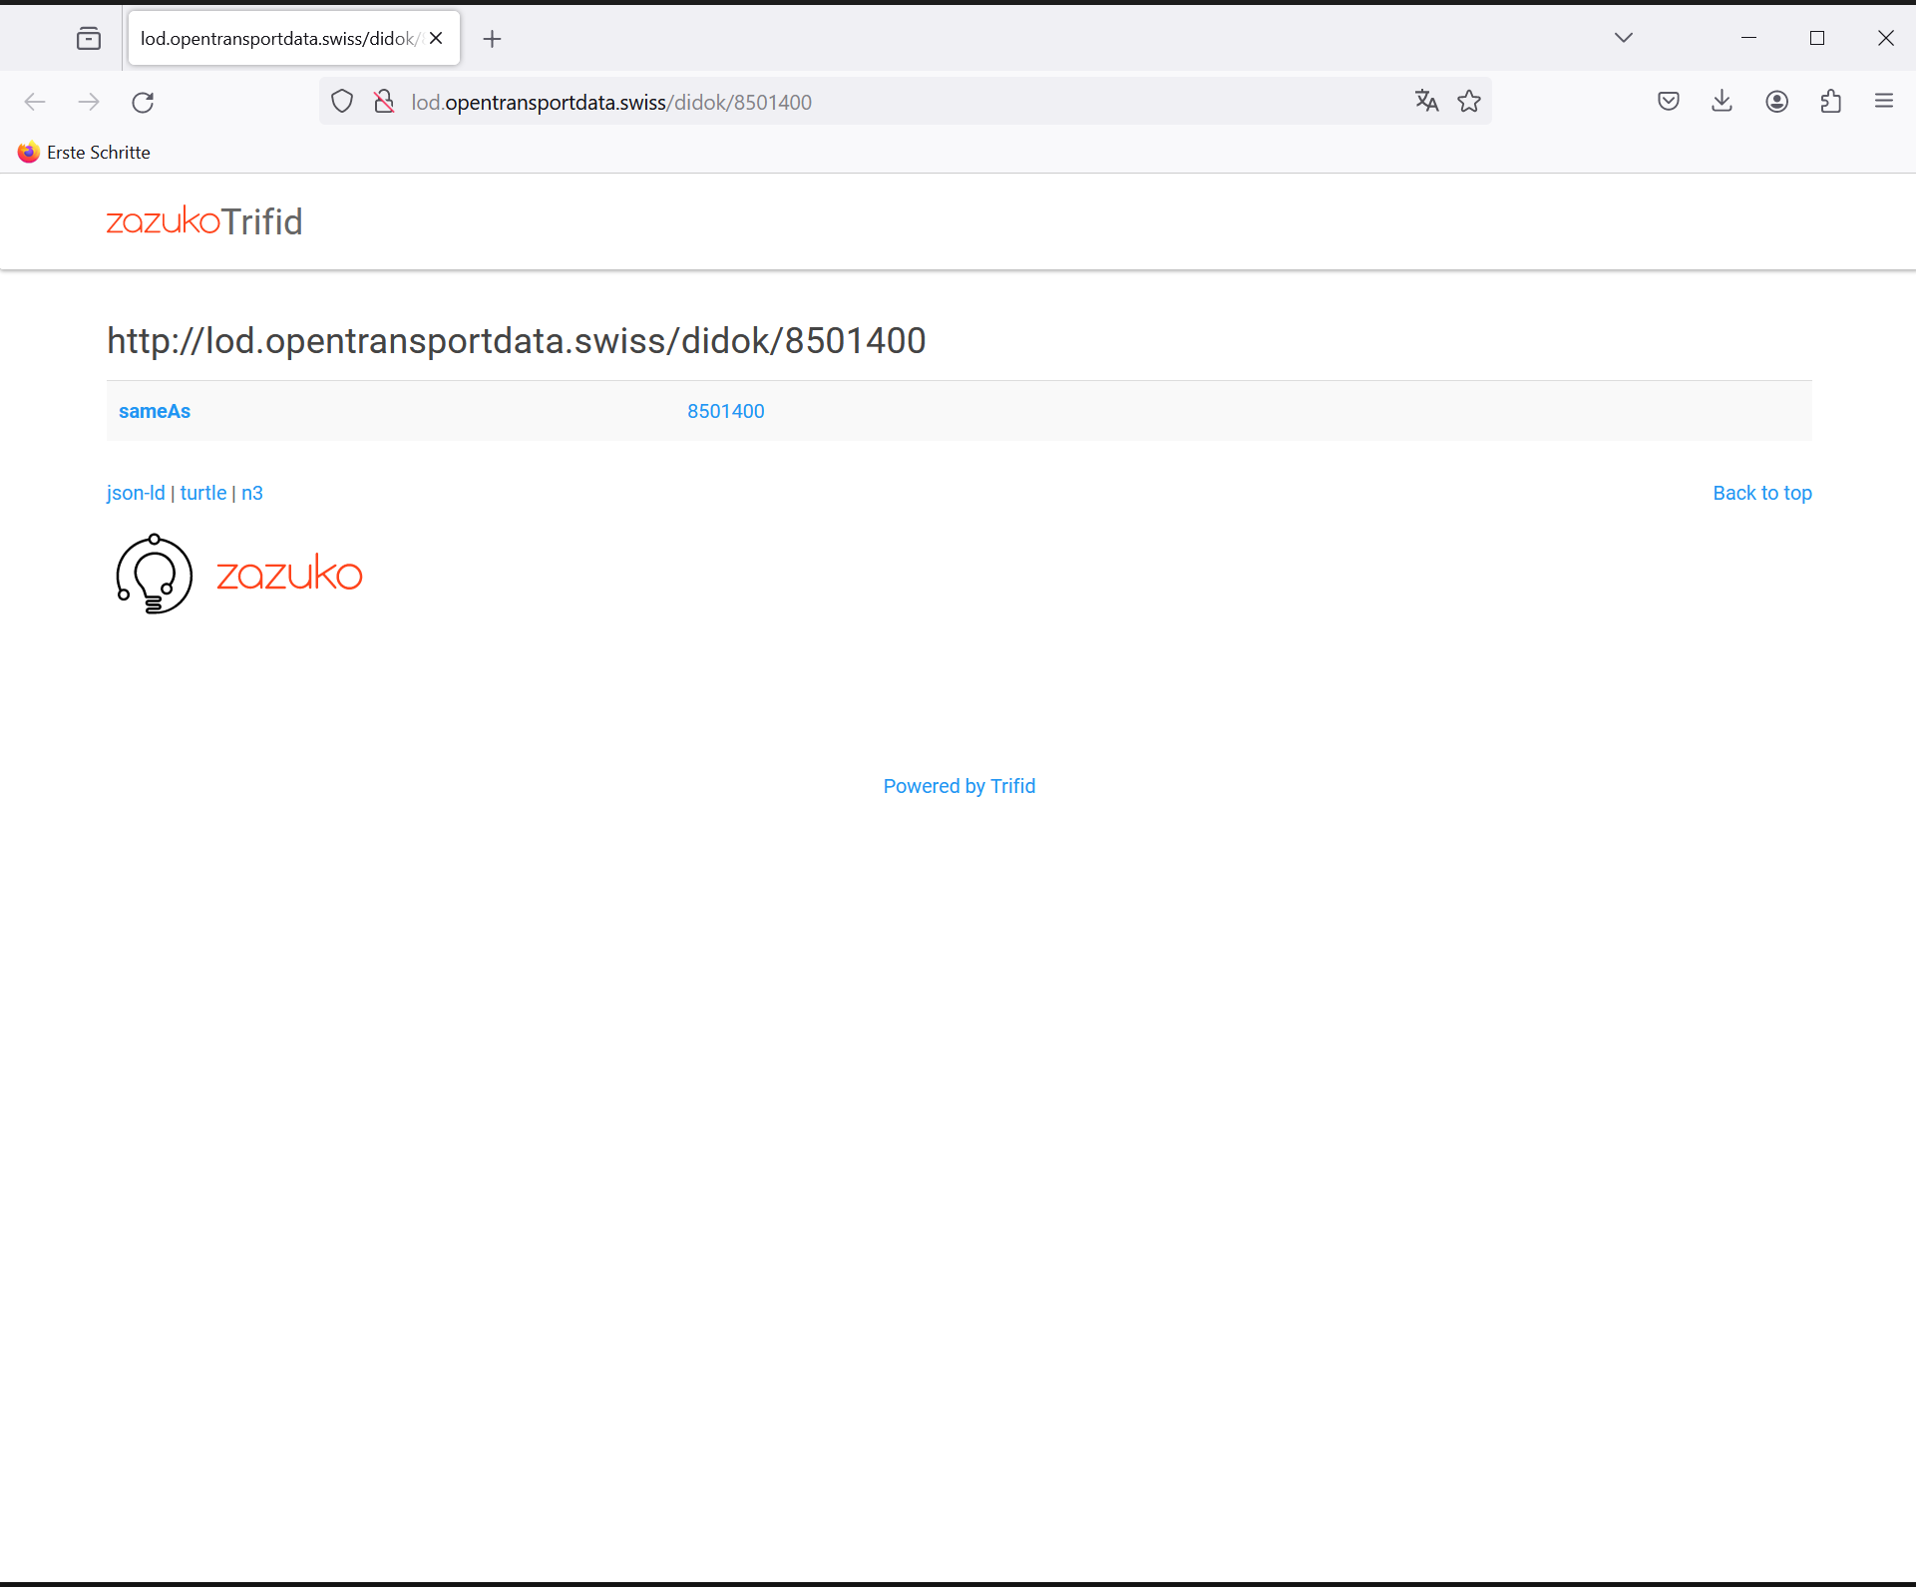
Hyperlink

Slide 9
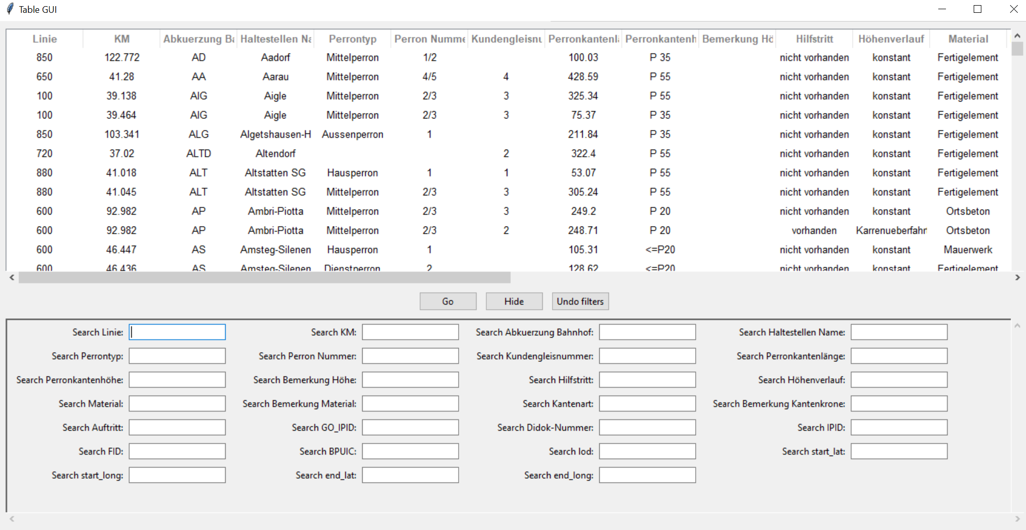
Filtering data

Slide 10
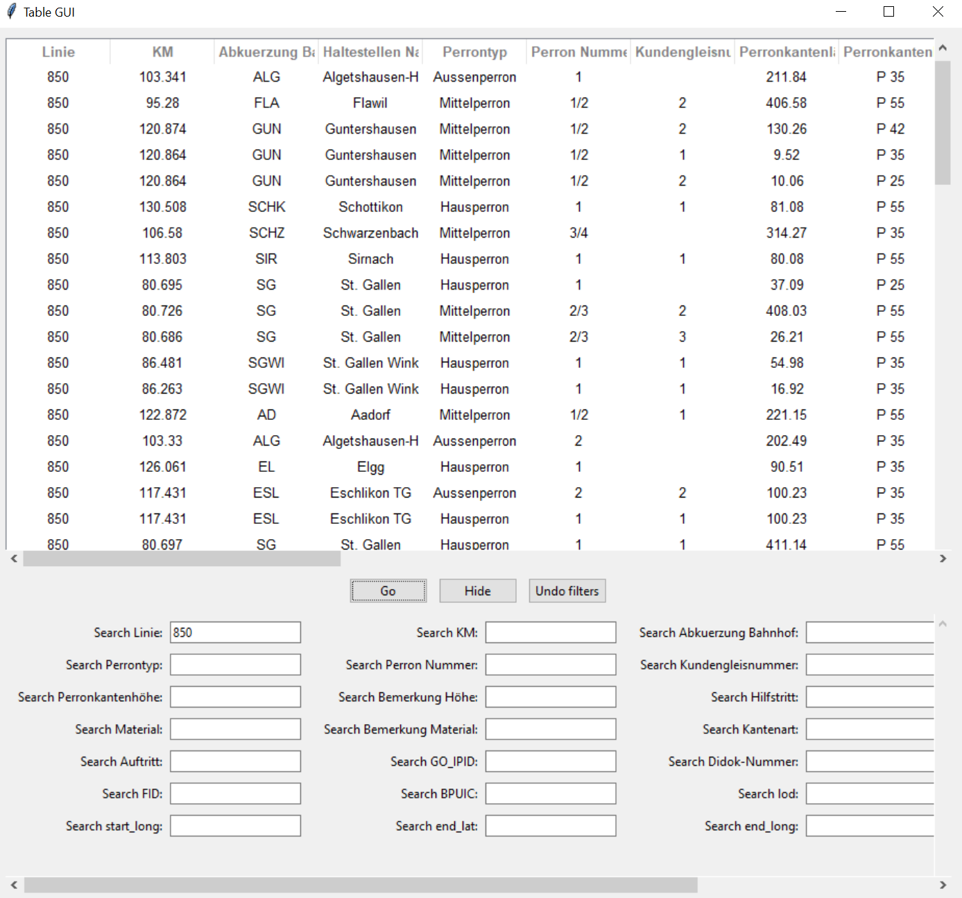

Slide 11
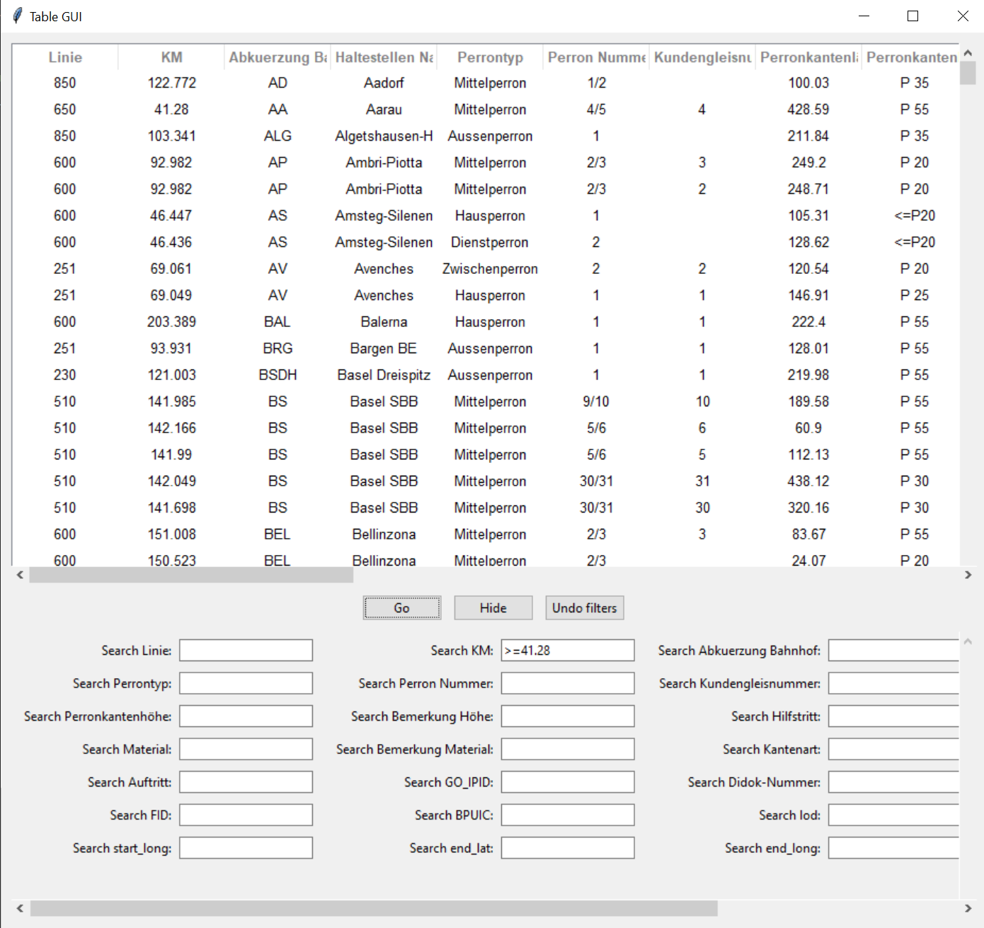
Assignment operators
<
<=
==
>=
>

Slide 12
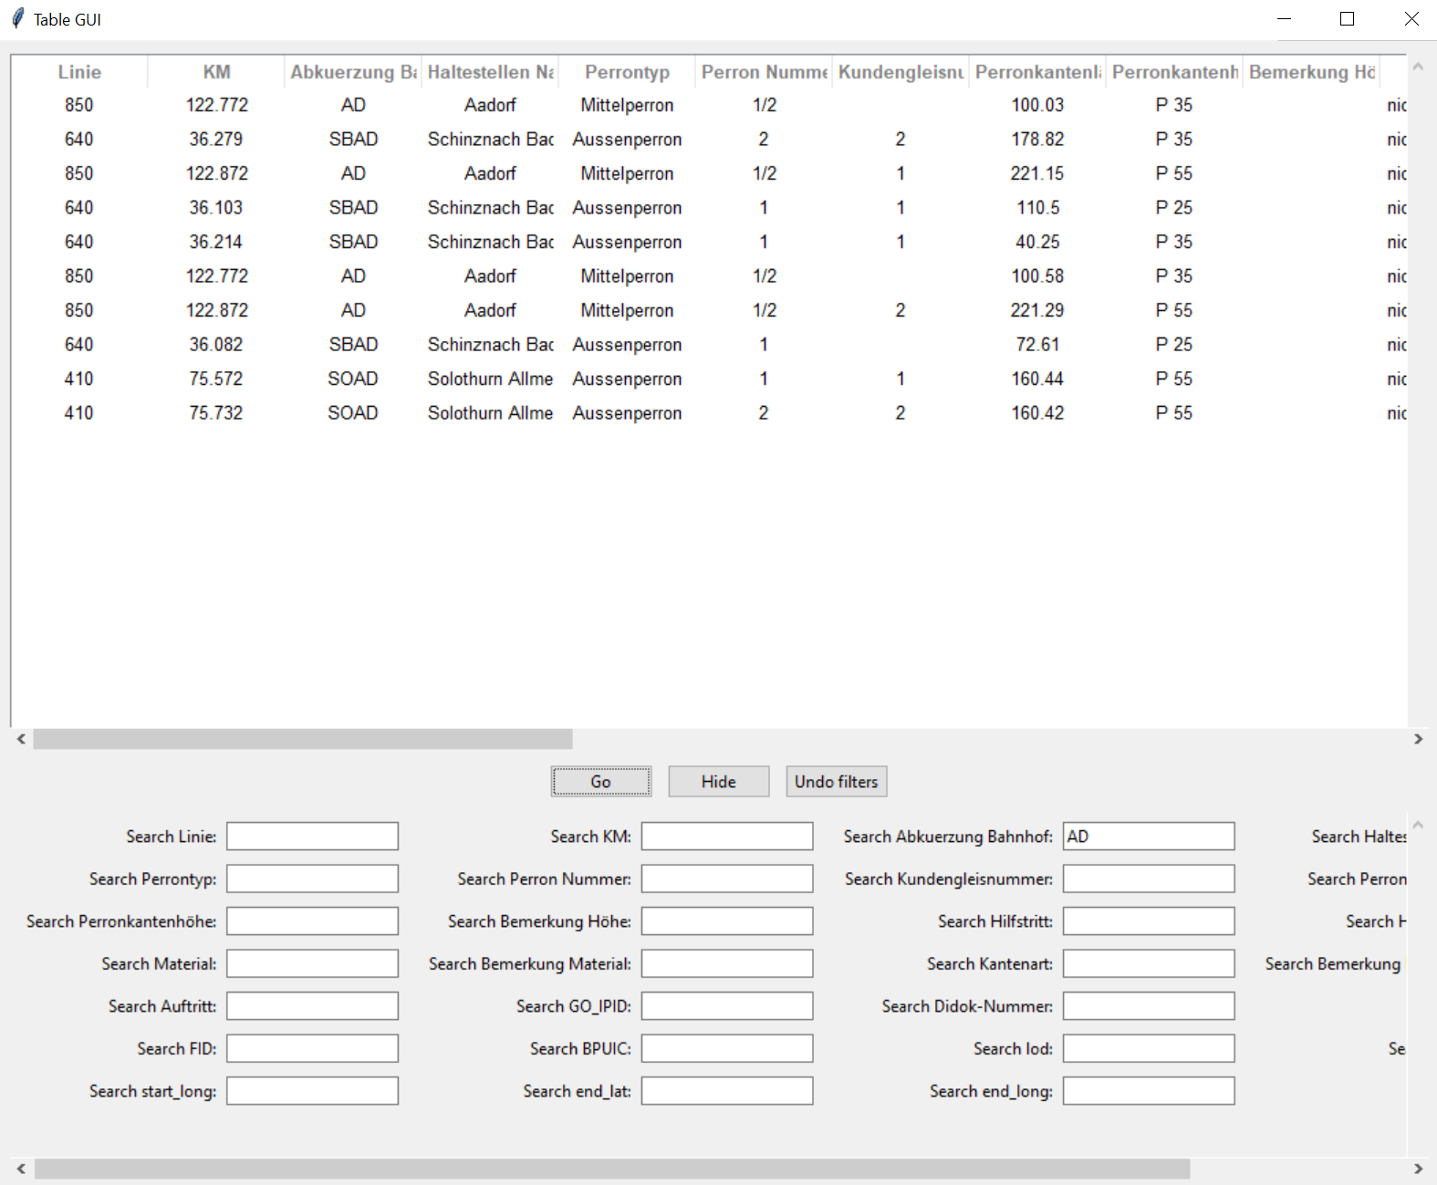
Filtering for all results

Slide 13
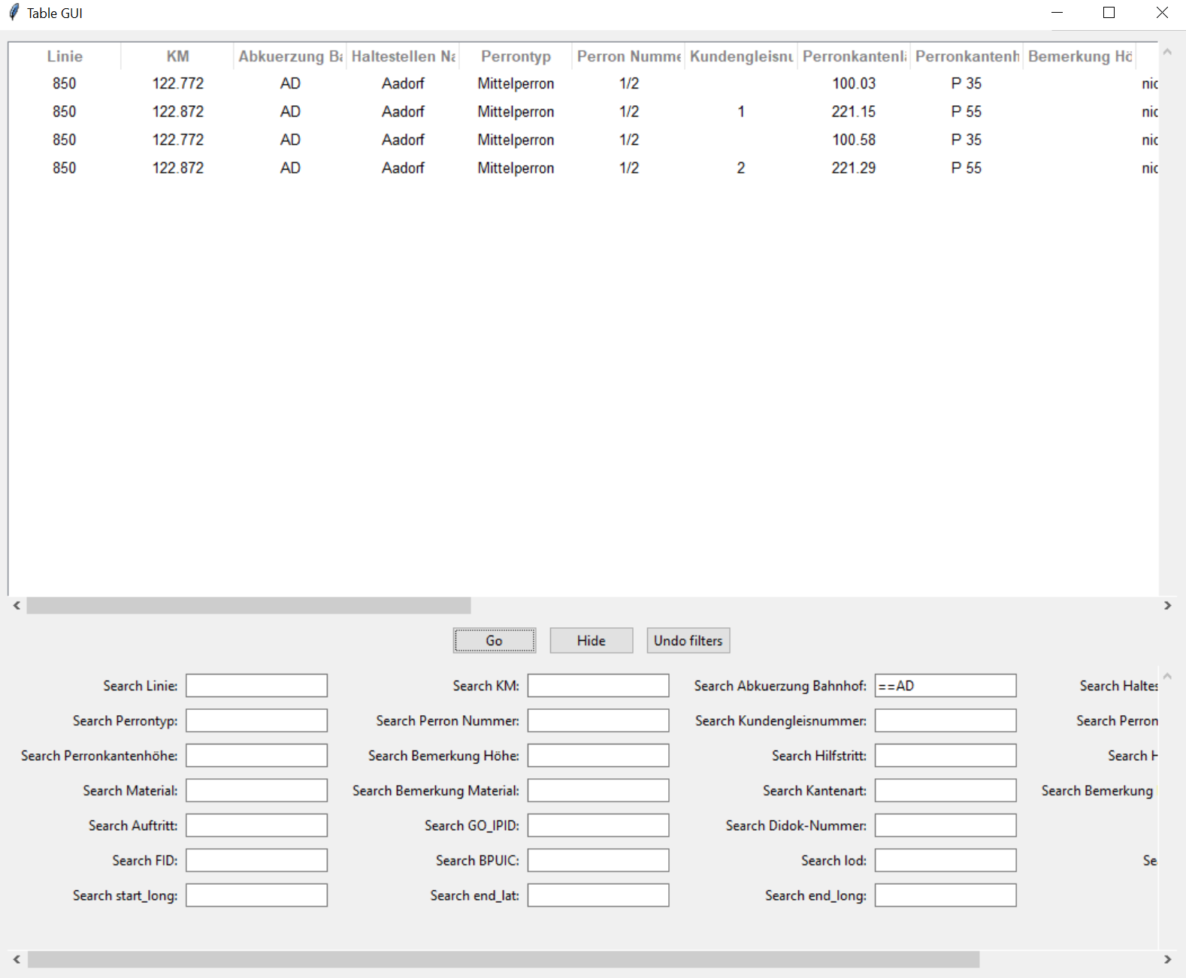
Filtering exact results
Assignment operator ==

Slide 14
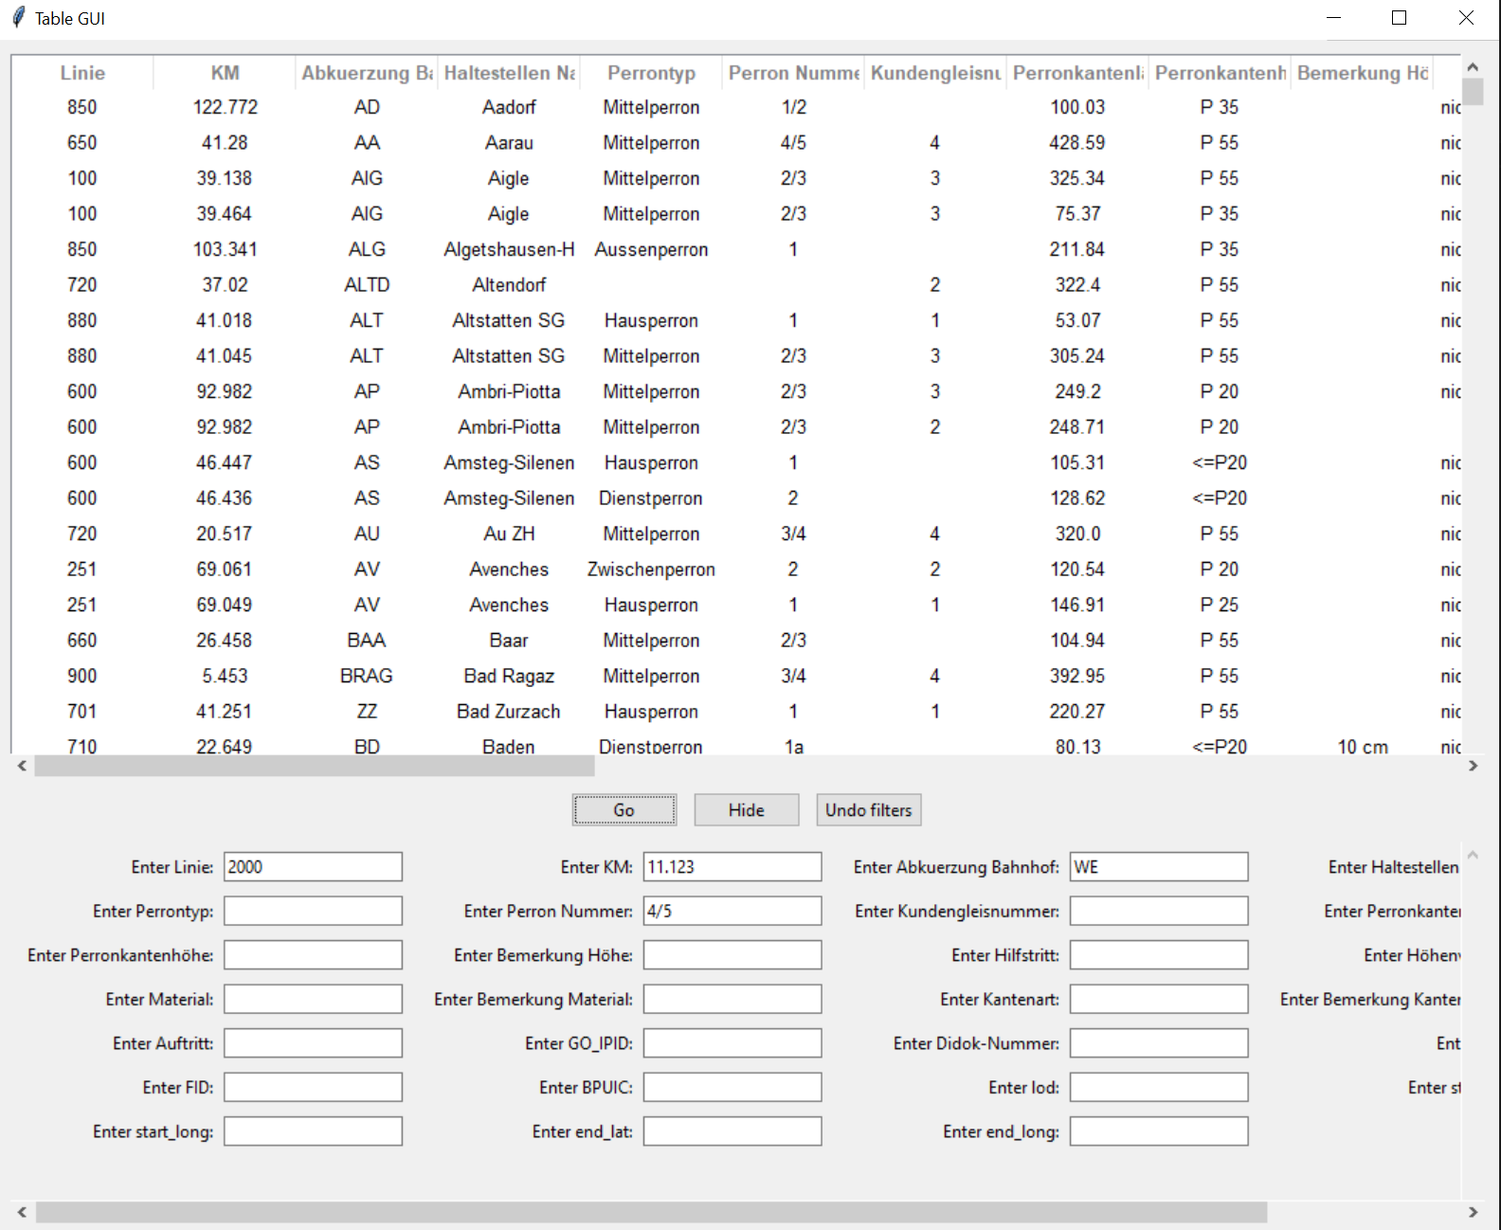
Adding data

Slide 15
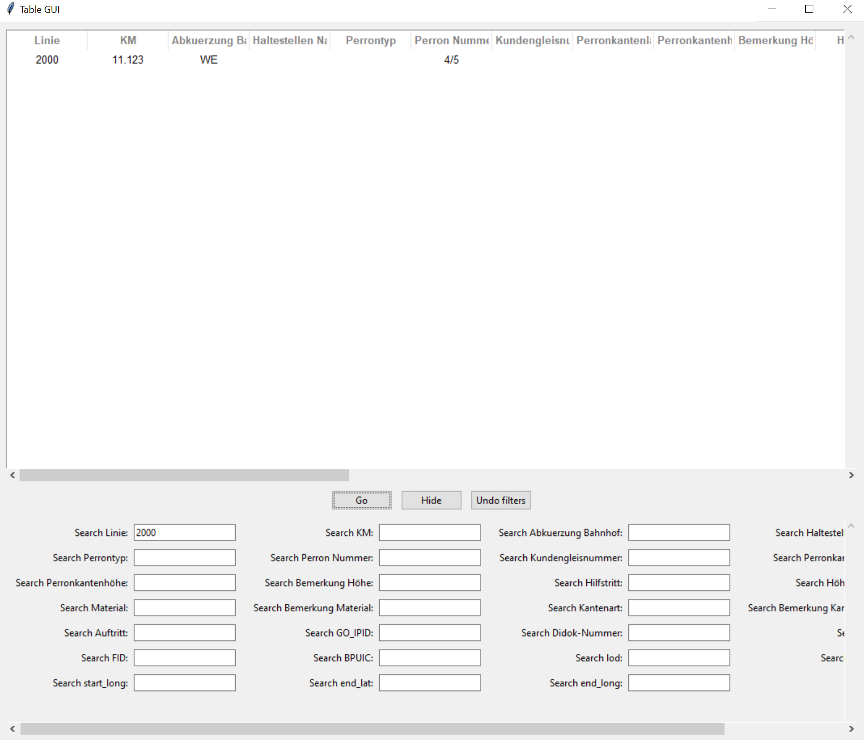

Slide 16
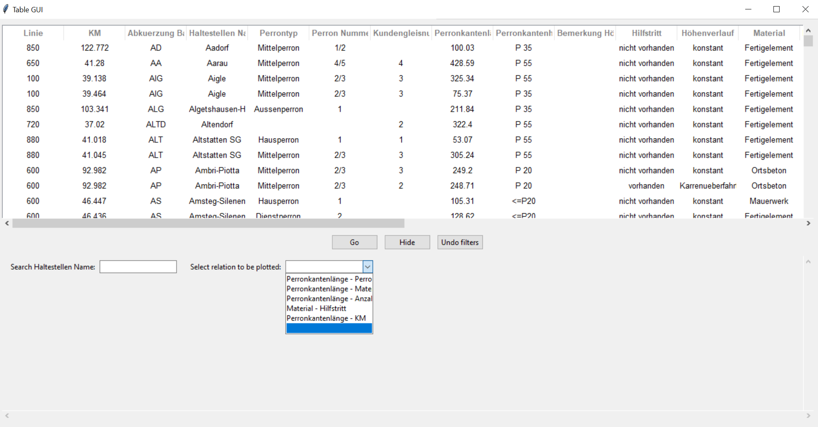
Plotting data

Slide 17
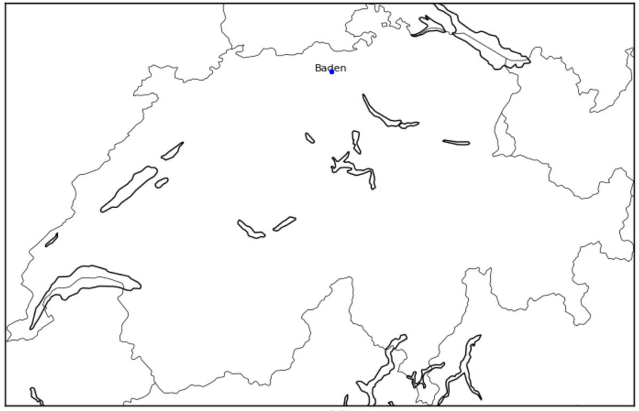
Plotting Baden

Slide 18
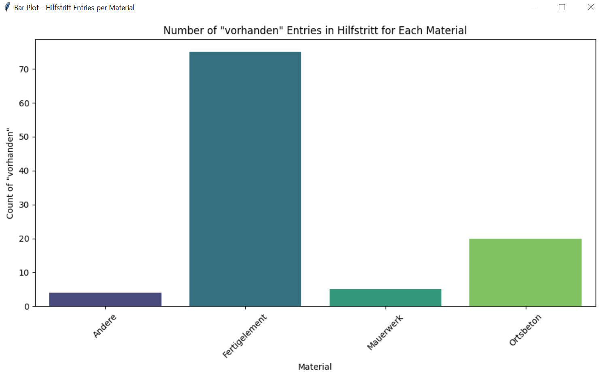
Number of „available“ entries in auxiliary step for each material

Slide 19
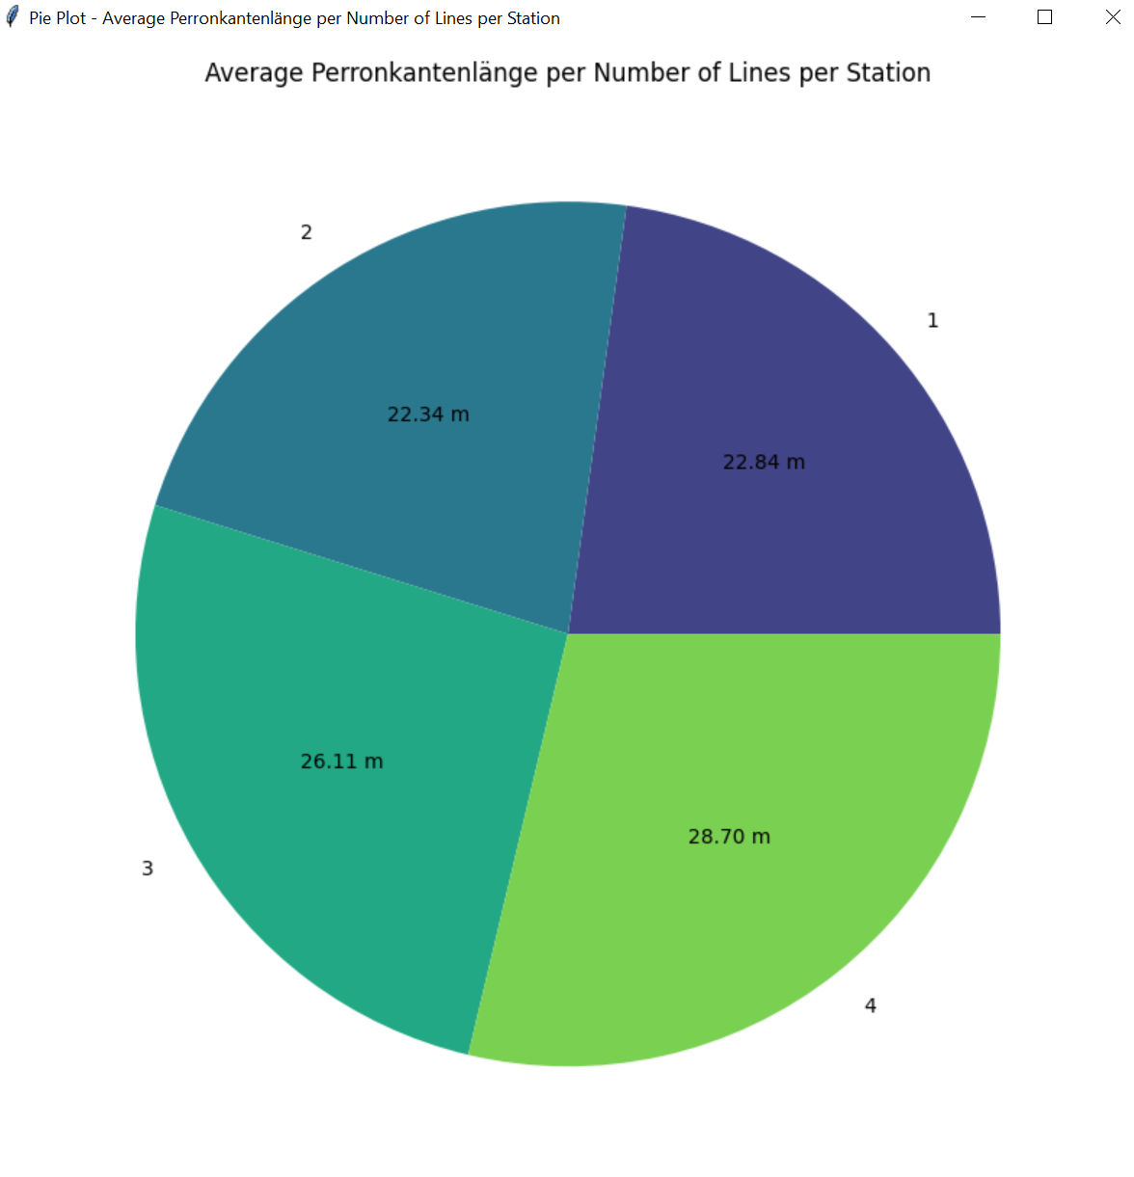
Average plattform edge length per number of lines per station

Slide 20
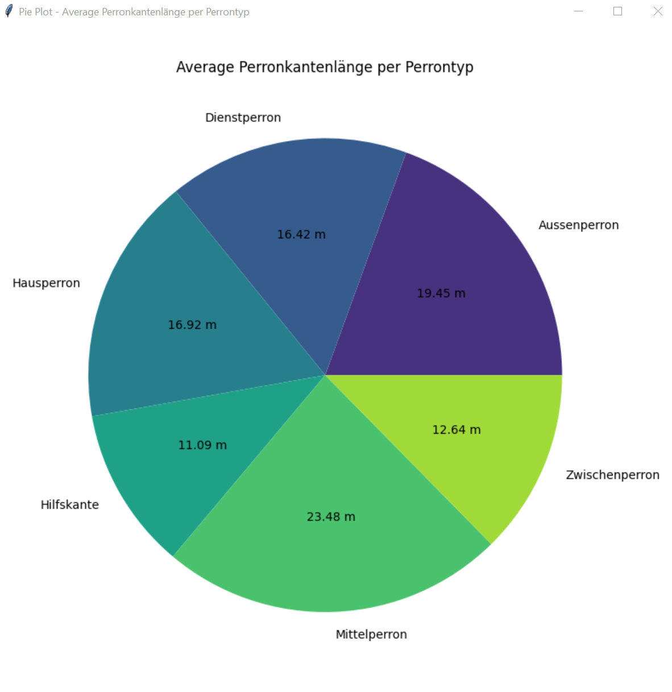
Average plattform edge length per plattformtype

Slide 21
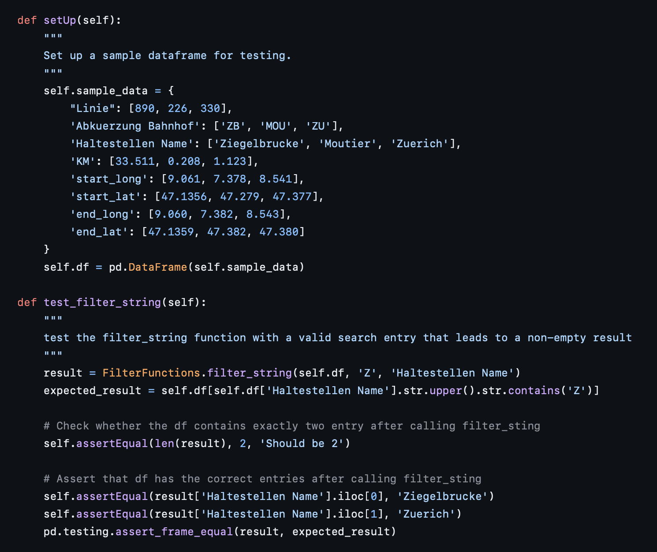
Unit test

Slide 22
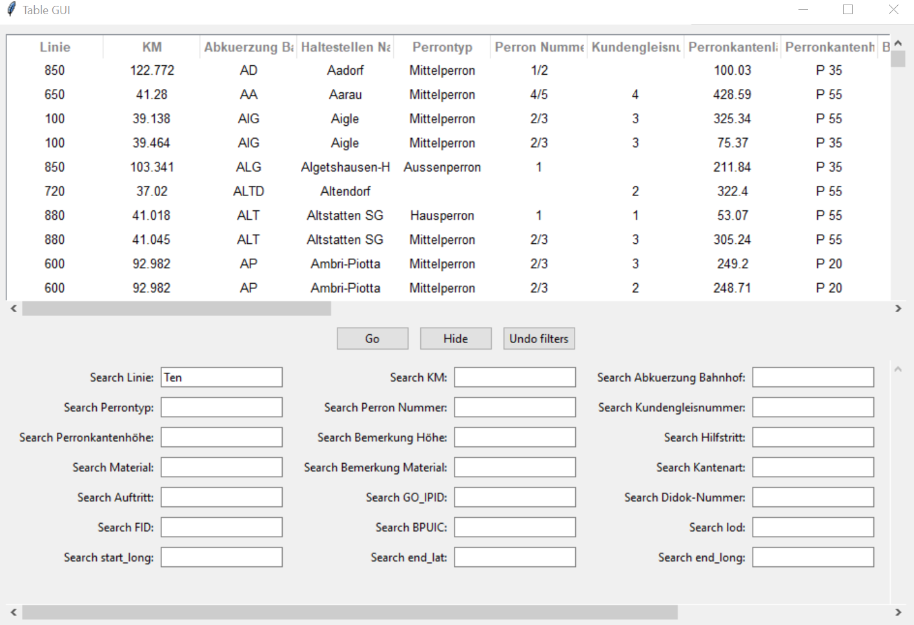
Sample error message by entering string in number field

Slide 23
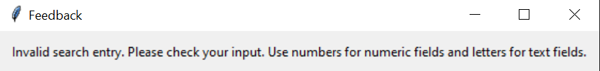
Feedback

Slide 24
Sample error when filtering the dataframe, however no user input was given

Slide 25
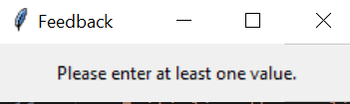
Result

Slide 26
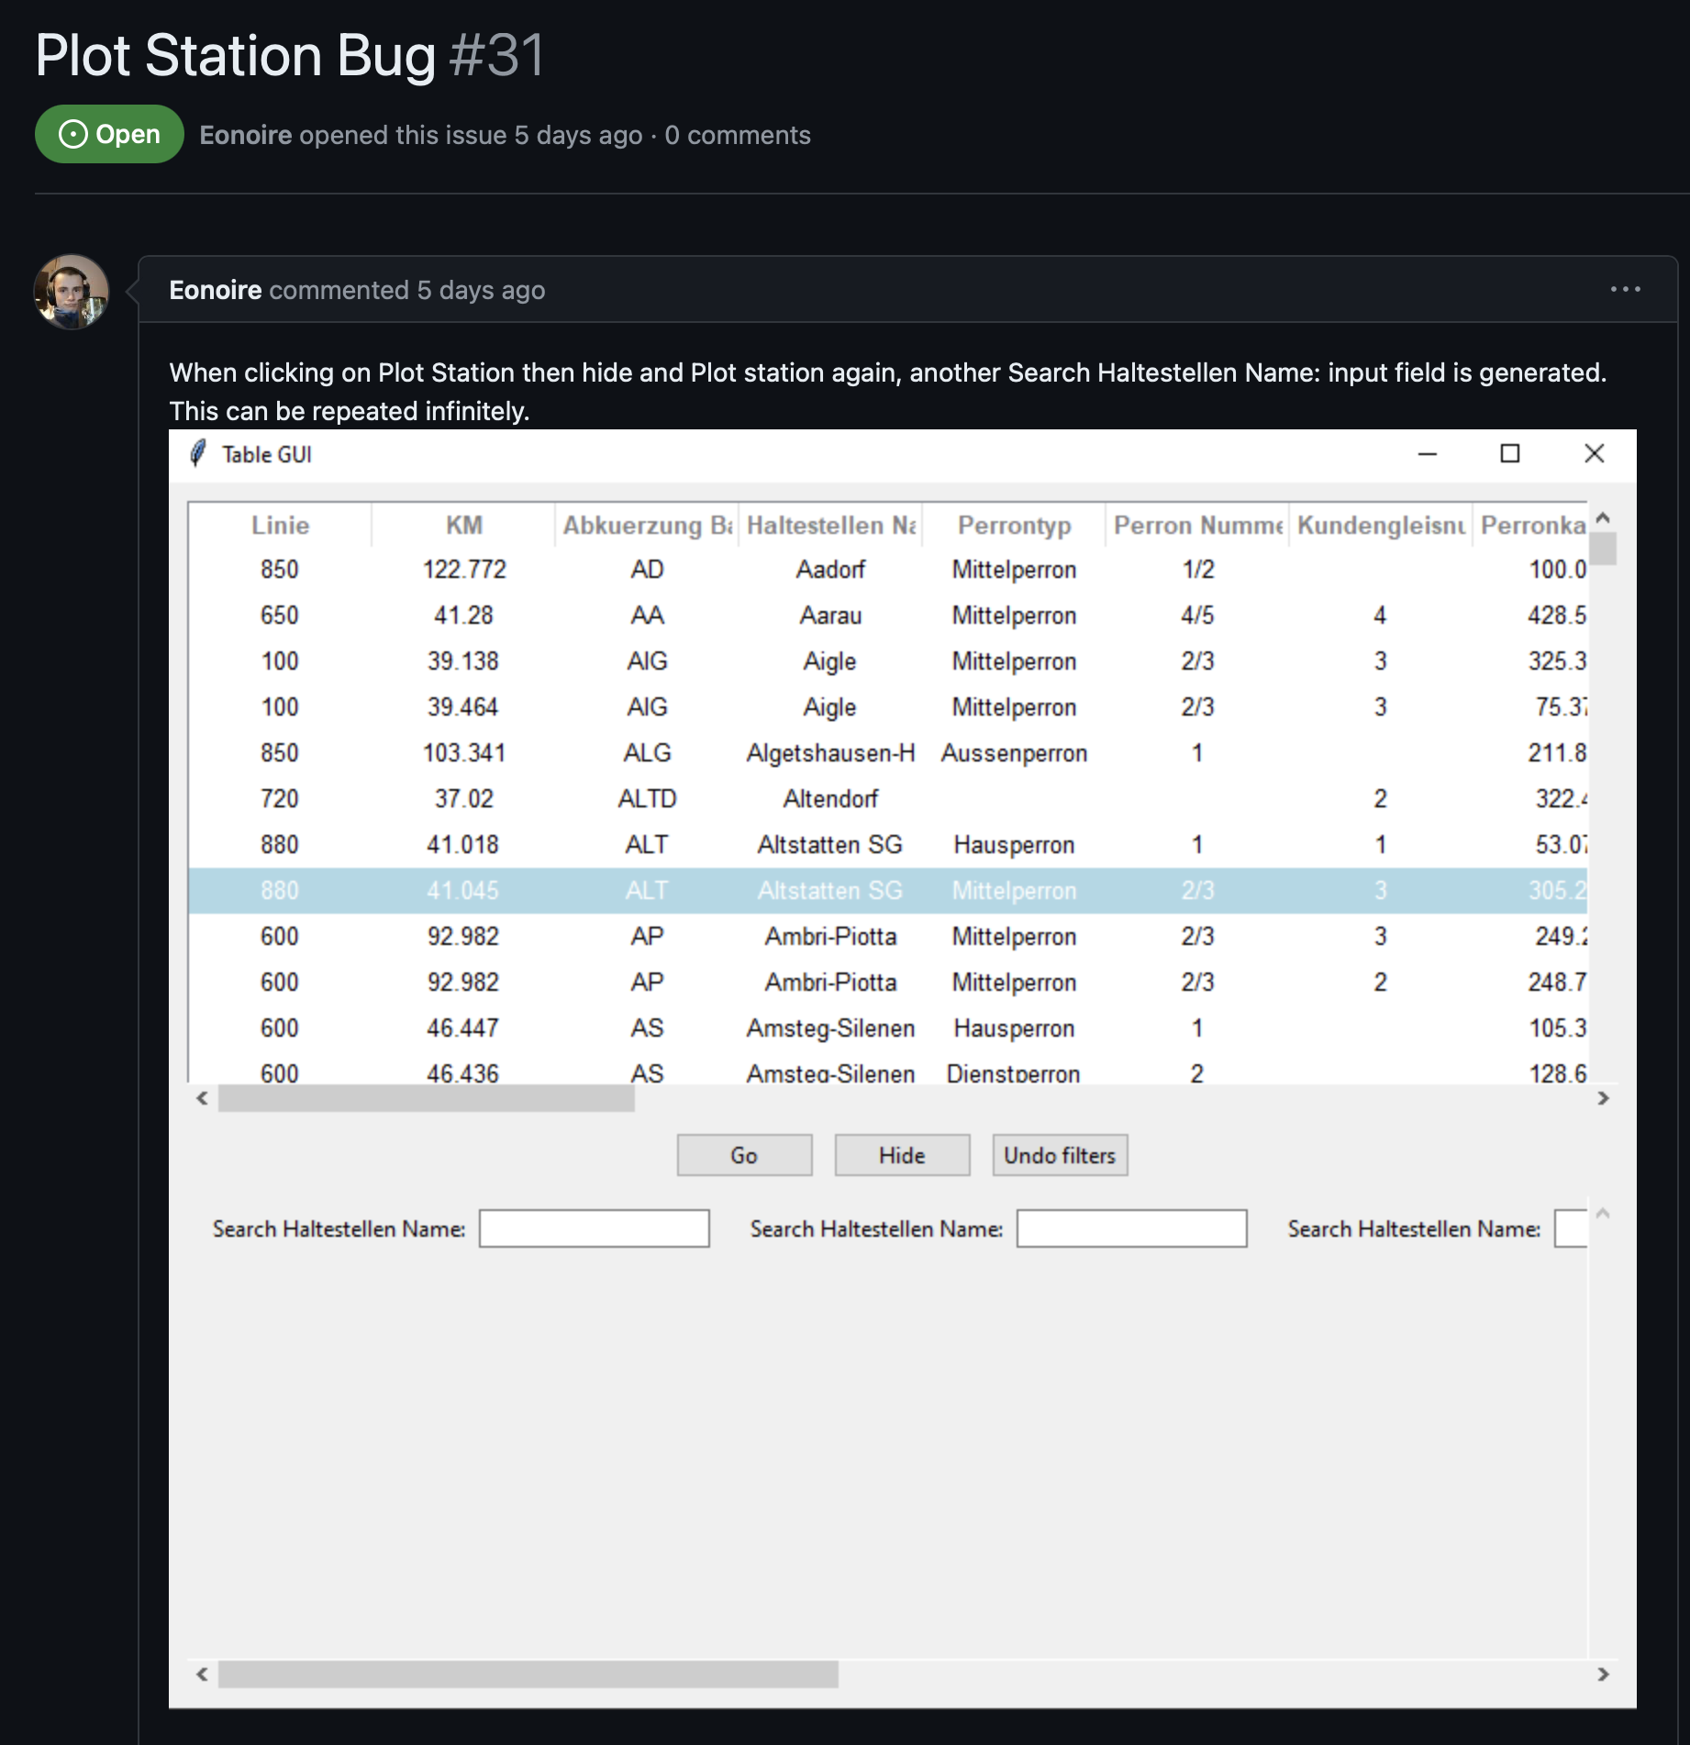
Feedback

Slide 27
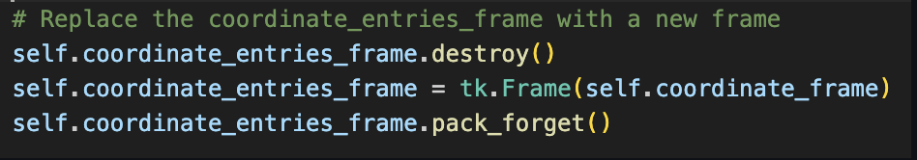
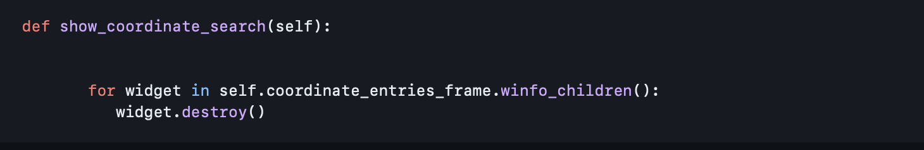
Two solutions, latter is more efficient

Slide 28
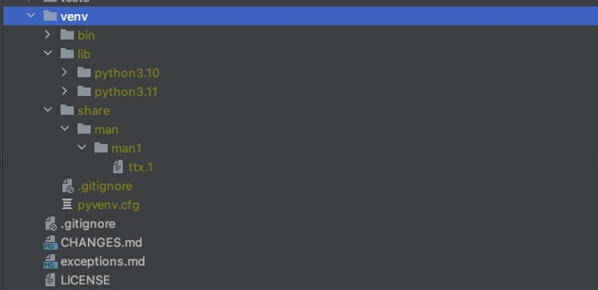
Virtual environment

Slide 29
Future work
Allow the user to edit or even delete the data
Restrictive control over data added by users (allow only fully completed entries)
Newly entered values are saved permanently

